Slide 1
3+1 Formalism
Young-Hwan Hyun (KASI)
2024.07.30. Tuesday
2024 GWNR Summer School
@Daejeon, Korea

Slide 2
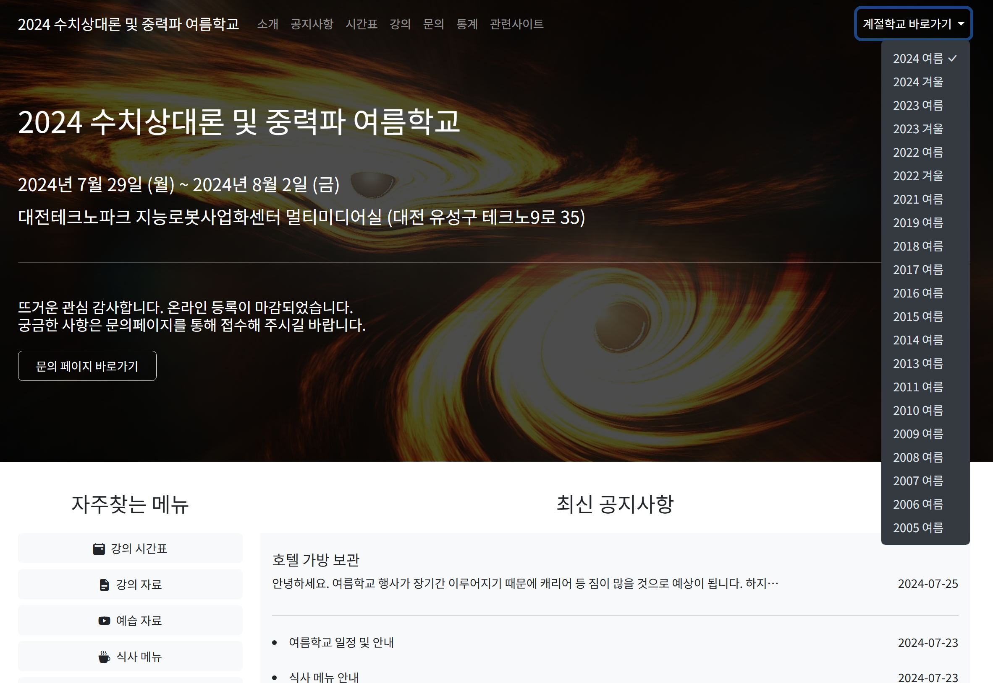

Slide 3
Things to learn in this lecture
We will understand
Einstein equation
Foliation of the spacetime
Intrinsic quantities of hypersurfaces
3+1 decomposition of the Einstein eq.
NR application
ADM formalism and ADM quantities

Slide 4
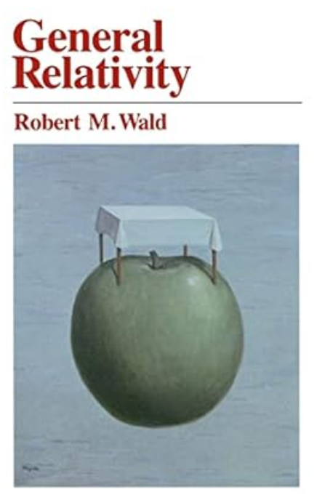
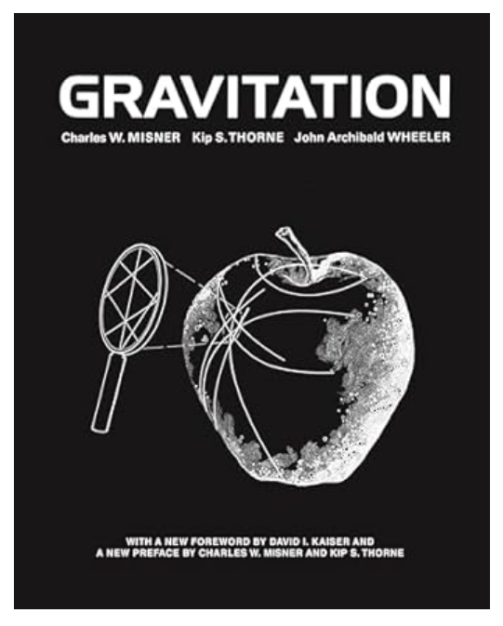
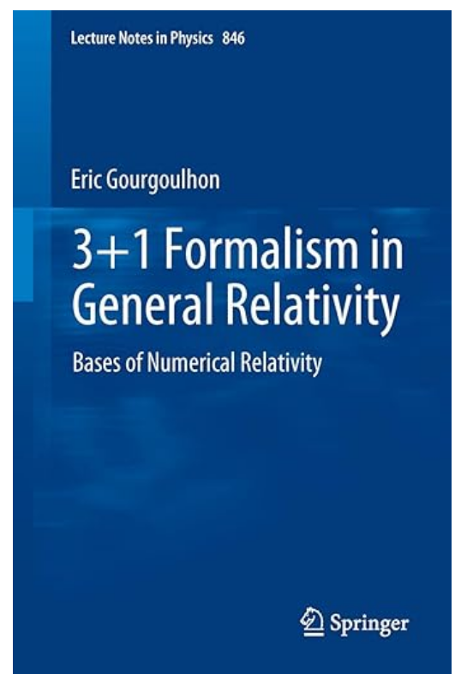
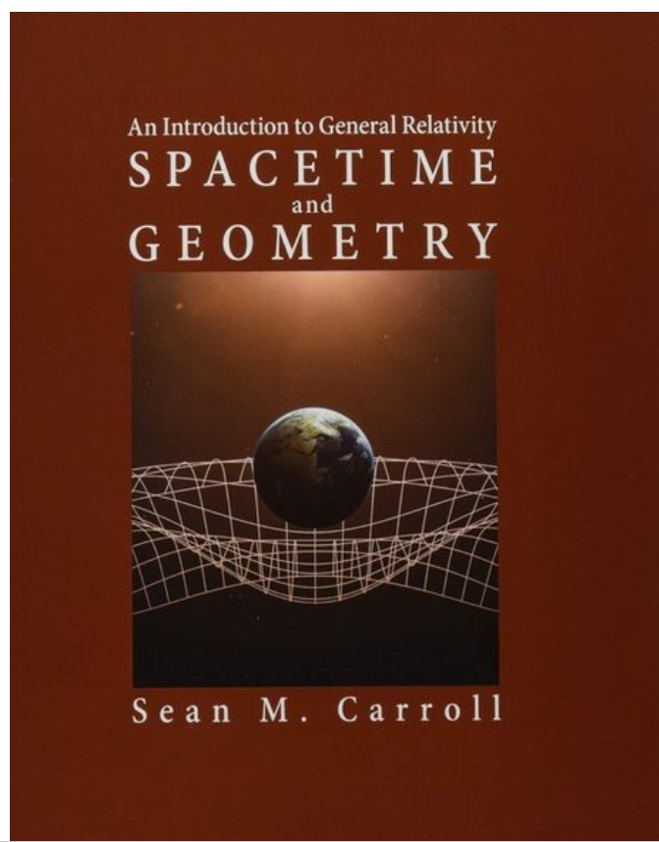
References

Slide 5
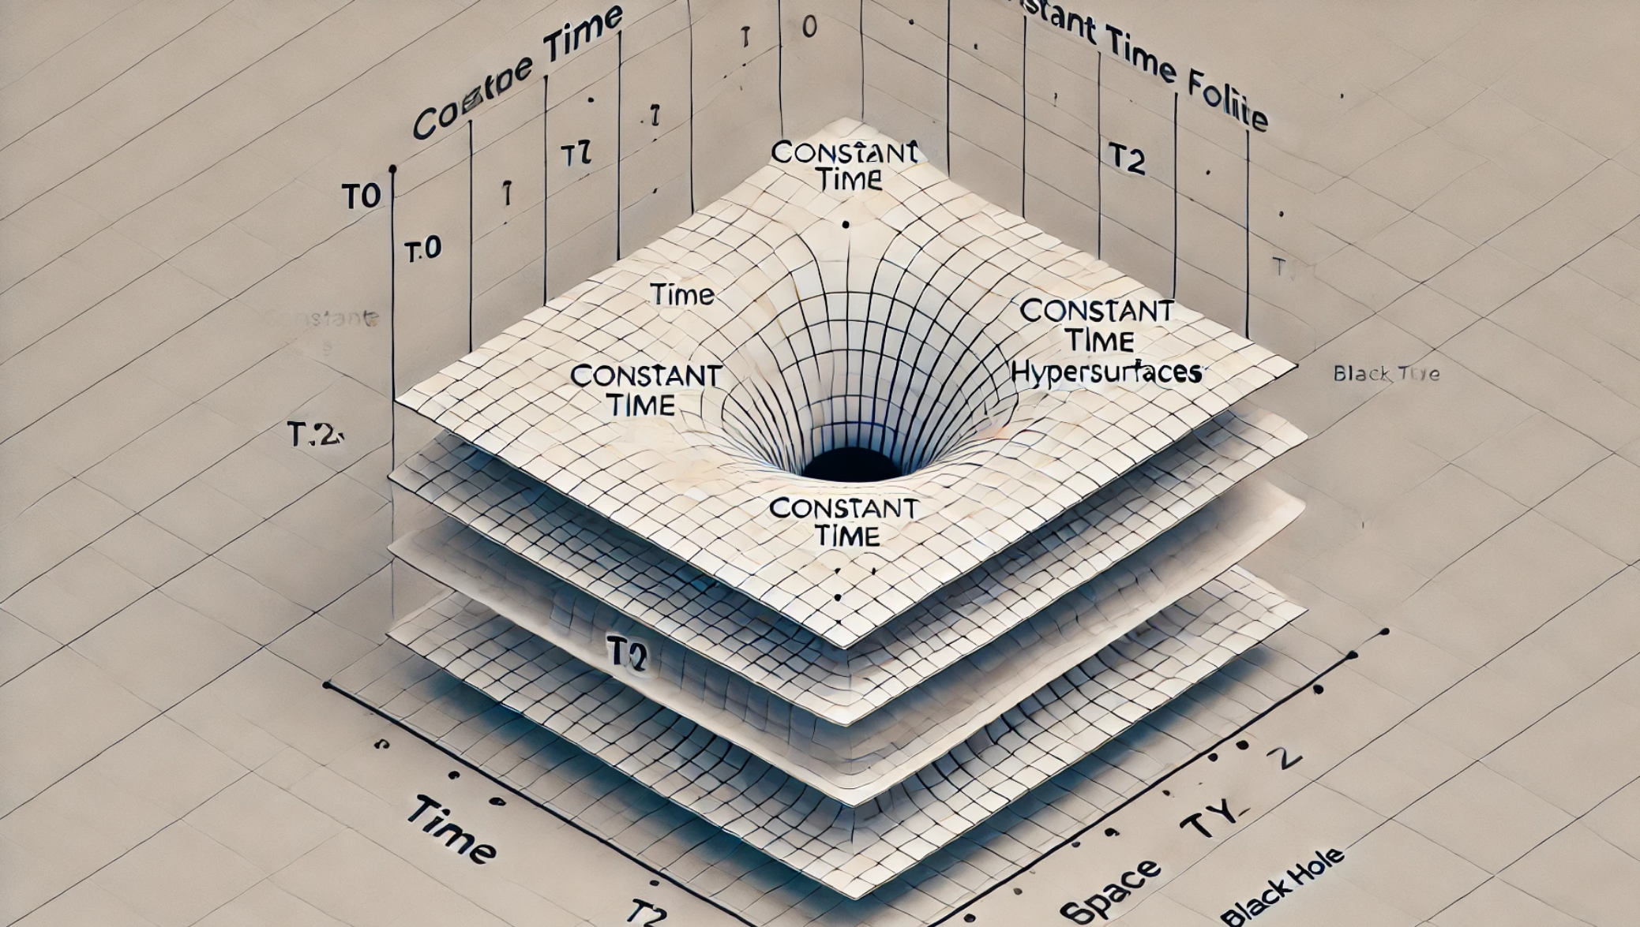
3+1=?

Slide 6
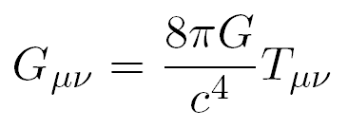
Elements in Einstein’s eq.
Einstein tensor
Newtonian gravitational constant
Speed of light
Energy-momentum tensor
Curvature of spacetime
Rank-2 symmetric tensor
4x4 matrix components
Divergence-free
General relativity
Accelerated objects
Related to gravity
- Special relativity
- Locally non-
gravitational physics
- Causal structure of
spacetime
Matter(Energy) distribution
Energy, momentum, pressure
Stars, galaxies, …
Standard model particle,
Dark matter, dark energy, vacuum, radiation….

Slide 7
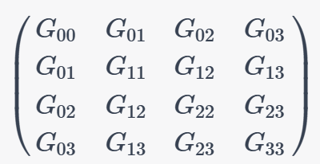
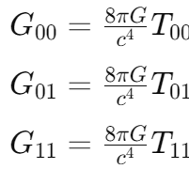
Counting # of eqns in Einstein’s eq.
Rank-2 tensor > 2 dimensional matrix
Index range: > 4x4 matrix
Symmetric tensor:
We have 10 eqns.:
3+1?

Slide 8
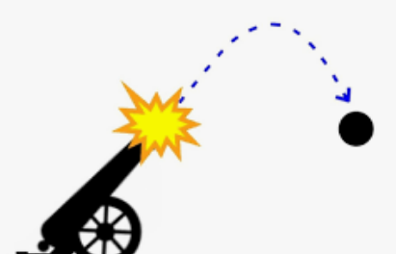
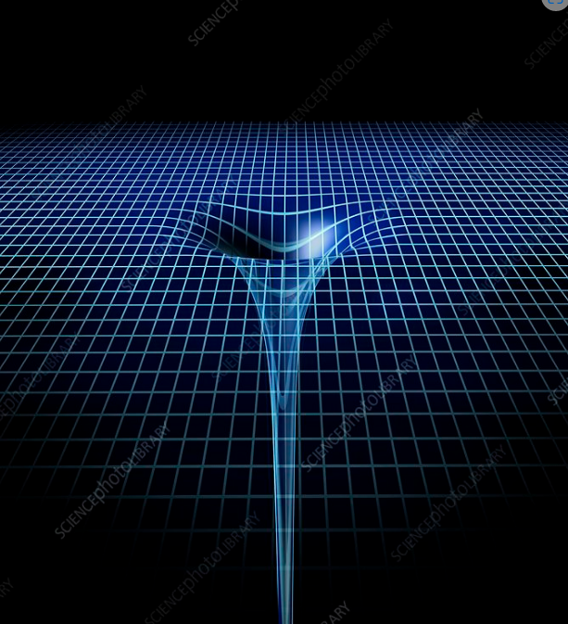
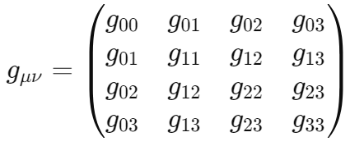
Variables in Einstein’s eq.
Metric tensor
Unknowns to solve in Einstein’s eq. such as x in f(x)=y.
Field variable, not x(t) but gμν(t,x)
Related to gravitational field g in Newtonian gravity
Describes the spacetime structure
Fundamental quantity: 4x4 symmetric tensor, 10 dof’s >> What is its value? 10 is real dofs? Why not just 3+1?
3+1?

Slide 9
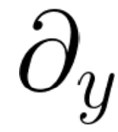
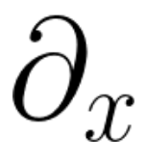
Metric tensor in Einstein eq.
?
Metric tensor components from coordinate basis
Differential geometry: basis vector > differential operator
2
1
0 1 2

Slide 10
Tangent /dual vector basis
y=2
2
1
0 1 2
y=1
y=0
$$1$$
$$\sqrt{5}$$
x=0
x=1
x=2

Slide 11
Metric tensor in Einstein eq.
?
Metric tensor components from coordinate basis
Information about the lengths and angles of the basis vectors

Slide 12
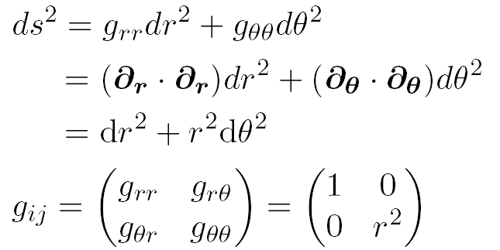
Metric tensor example
2-D Polar coordinates
Alternative coordinate system of flat 2-D space
Orthogonal coordinates
Symmetric tensor > metric tensor property
Diagonal components indicates lengths of the basis

Slide 13
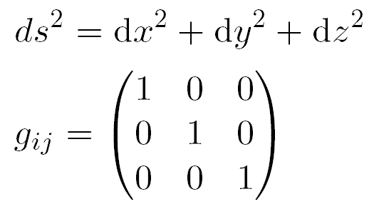
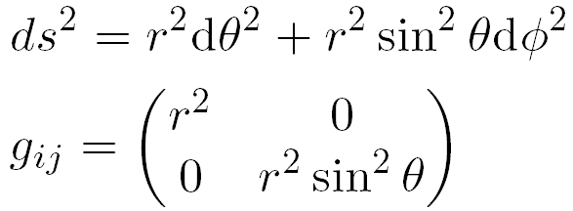
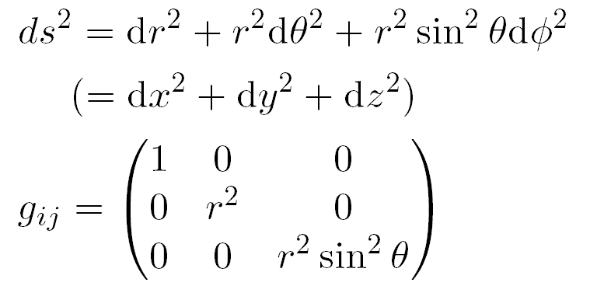
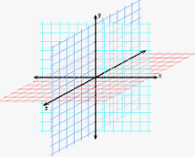
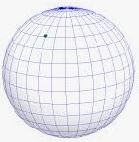
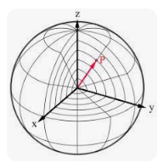
Metric tensor examples
3-D flat space 2-D sphere surface 3-D spherical coordinates

Slide 14
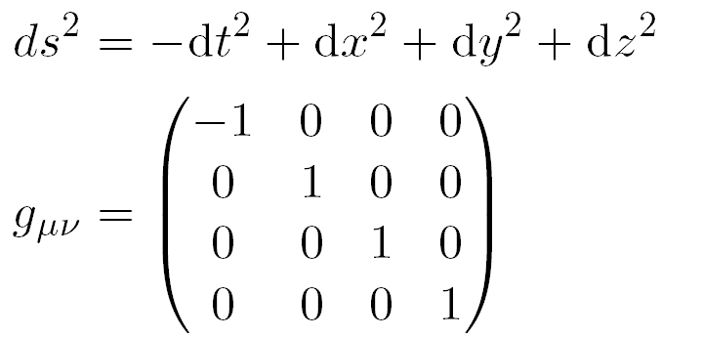
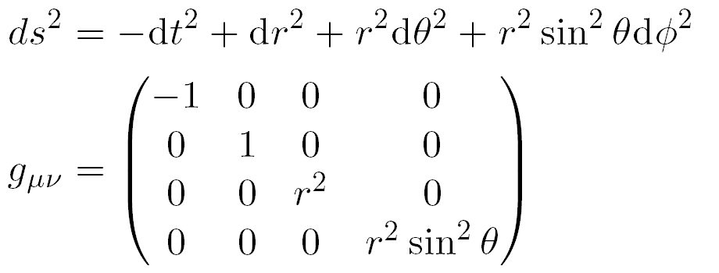
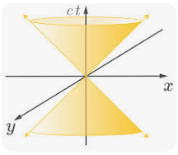
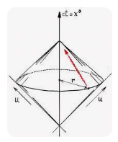
Metric tensor examples (Pseudo-Riemannian, Flat)
4-D flat Minkowski spacetime (Cartesian) 4-D flat Minkowski spacetime (Spherical)

Slide 15
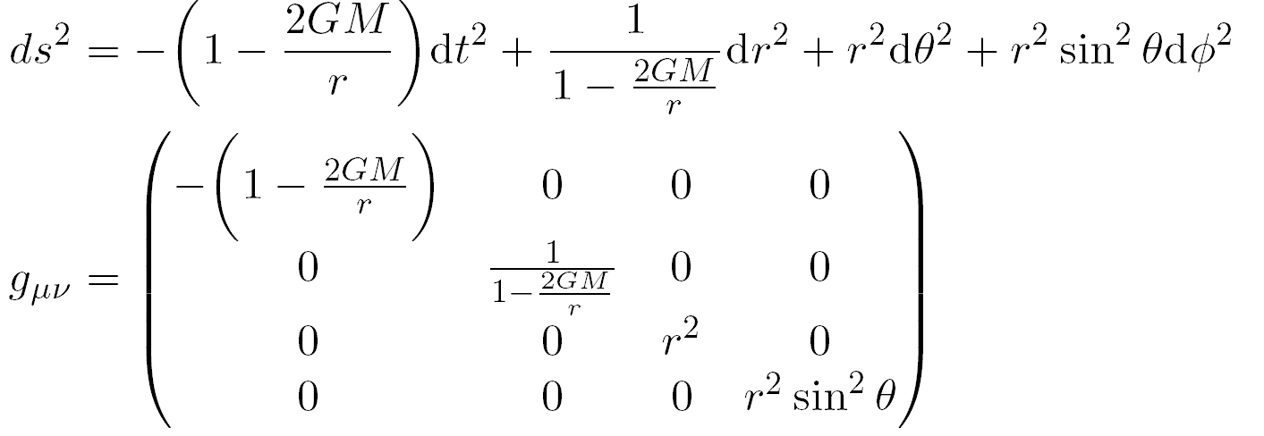
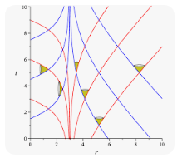
Metric tensor examples (Pseudo-Riemannian, Curved)
4-D curved spacetime

Slide 16
(Revisit) Variables in Einstein’s eq.
Metric tensor
Unknows to obtain by solving Einstein’s eq. such as x in f(x)=g.
Field varible, not x(t) but gμν(t,x)
Related to gravitational field g in Newtonian gravity
Describes the spacetime structure
Fundamental quantity: 4x4 symmetric tensor, 10 dof’s >> What is its value? 10 is real dofs? Why not just 3+1?
3+1?

Slide 17
No absolute coordinates in GR
No absolute position. What matters are intervals and causal structures. > Diffeomorphism invariance, Covariance under coordinate transformations
1
1
1

Slide 18
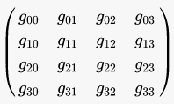
Physical dofs of metric tensor
Considering the gauge fixing, we have 6 physical dof’s in the metric.
10 → 6
10 → 6

Slide 19
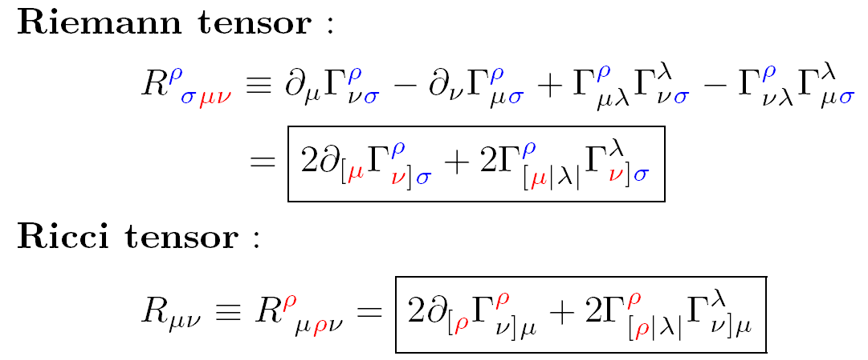
3+1 decomposition (Einstein tensor again)
We don’t know the exact functional form of G in terms of g yet.
?

Slide 20
3+1 decomposition (Einstein tensor again)
2nd order PDE of

Slide 21
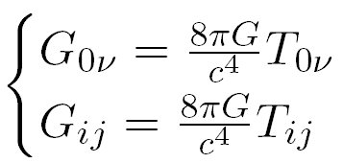
3+1 depends on Coordinate Choice.
Problems in the direct use of g00, g01, ….
Not gauge invariant quantities
Decompose Einstein eq. in a coordinate independent way
We can deal with a specific slice of the spacetime and evolve it.
Initial value problem, numerical relativity, ADM formalism, …
2
1
0 1 2

Slide 22
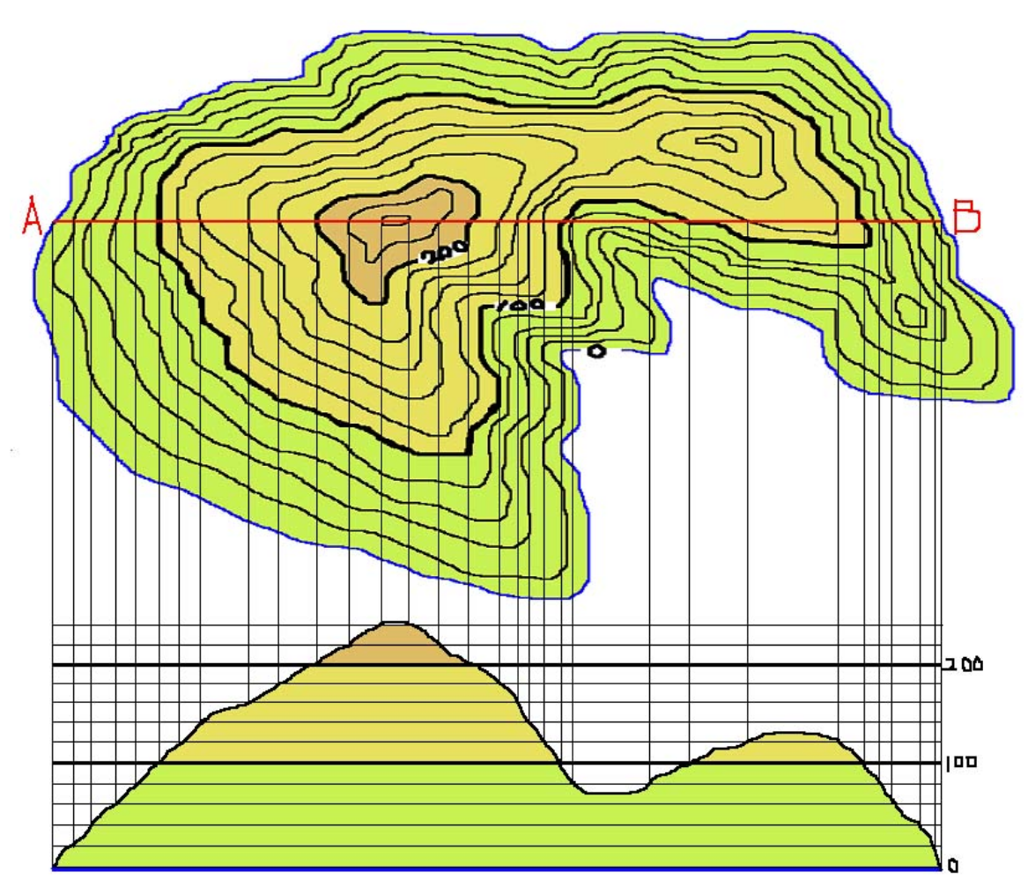
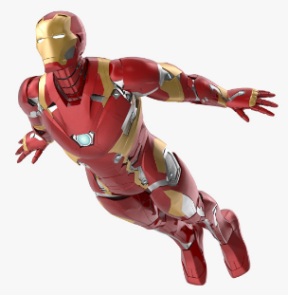
3+1 decomposition (coordinate invariant way)
Foliation of the spacetime (manifold > hypersurface (codimension-1 submanifold))
Fixing coordinate system (coordinate scalar field) > Determines how to slice the spacetime into constant time hypersurfaces (leaves)
The hypersurface are characterized by their normal vector > one-form basis of time
Spatial coordinates are set by defining curves along which the spatial coordiantes remain constant > tangent basis of time

Slide 23
3+1 decomposition (coordinate invariant way)
Foliation of the spacetime
Constant time hypersurface > normal vector: dt (not unit length) > unit normal vector: n > normal vector with length to next t=1 hypersurface: m (|m|=lapse N)
Draw constant x=0 curve > tangent basis until next grid: ∂t > difference of ∂t from m = shift vector: β
Information of bases on the hypersurface > γij
$$\left|m\right|… lapse$$
t=2
2
1
0 1 2
t=1
t=0
$$n m$$

Slide 24
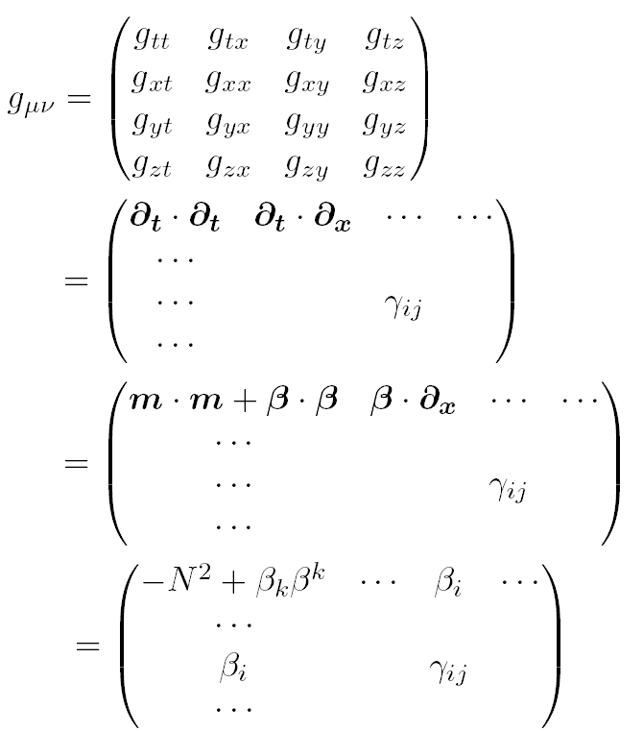
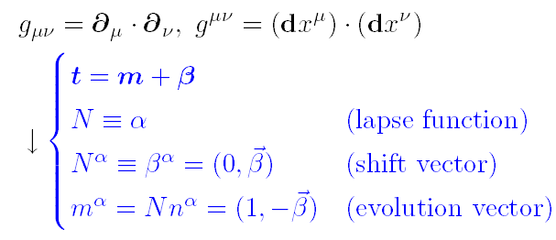
3+1 decomposition (metric decomposition)
$$\left|m\right|… lapse$$
2
1
0 1 2
$$n m$$

Slide 25
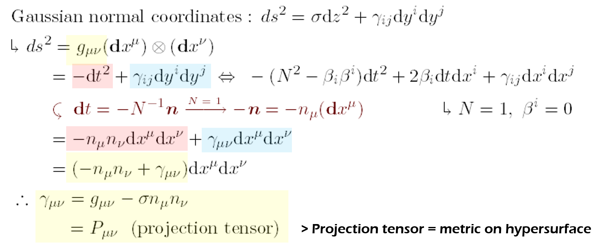
3+1 decomposition (projection tensor)
$$\left|m\right|… lapse$$
2
1
0 1 2
$$\left|m\right|… lapse=1$$
2
1
0 1 2
$$n m$$
$$n m$$
1

Slide 26
3+1 decomposition (projection tensor (2))
Definition:
Projected vectors are tangent to the hypersurface.
Act like the metric for tangent vectors
Idempotent f(f(x))=f(x)
$$\left|m\right|… lapse=1$$
2
1
0 1 2
$$n m$$
1

Slide 27
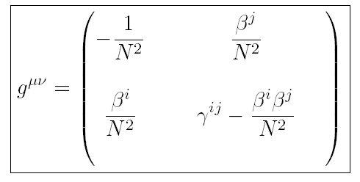
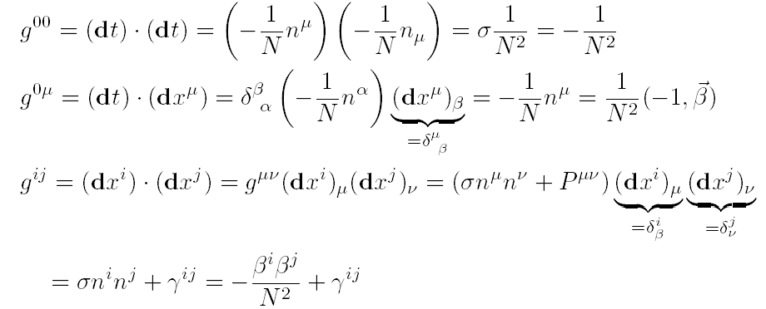
3+1 decomposition (inverse metric)
$$\left|m\right|… lapse$$
2
1
0 1 2
$$n m$$

Slide 28
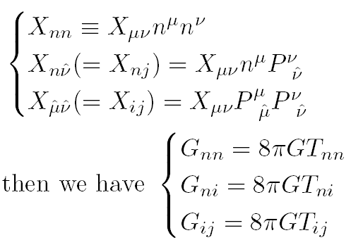
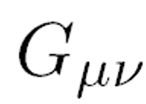
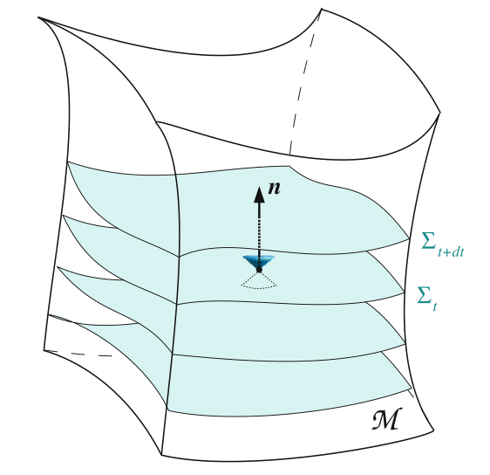
3+1 decomposition (Einstein tensor)
Vector decomposition:
Einstein tensor decomposition:
V
$$n$$
1
[Gourgoulhon, 2021]

Slide 29
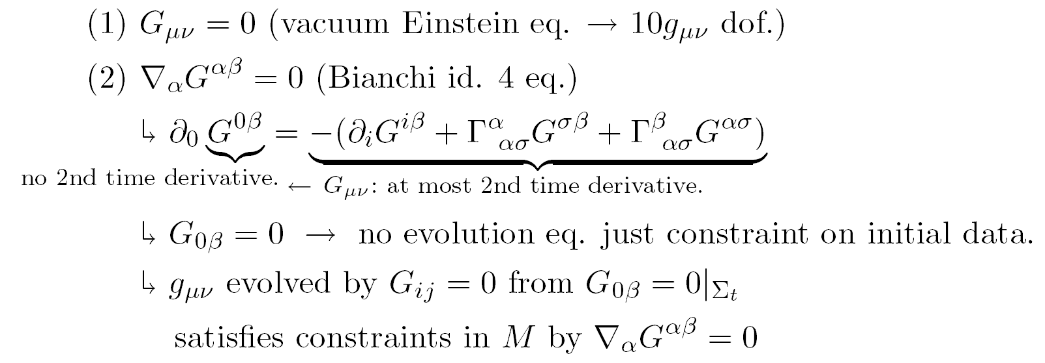
Constraints and evolution eq.

Slide 30
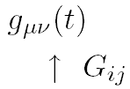
Initial value formulation: constraints
> “Initial value formulation” is well-posed.

Slide 31
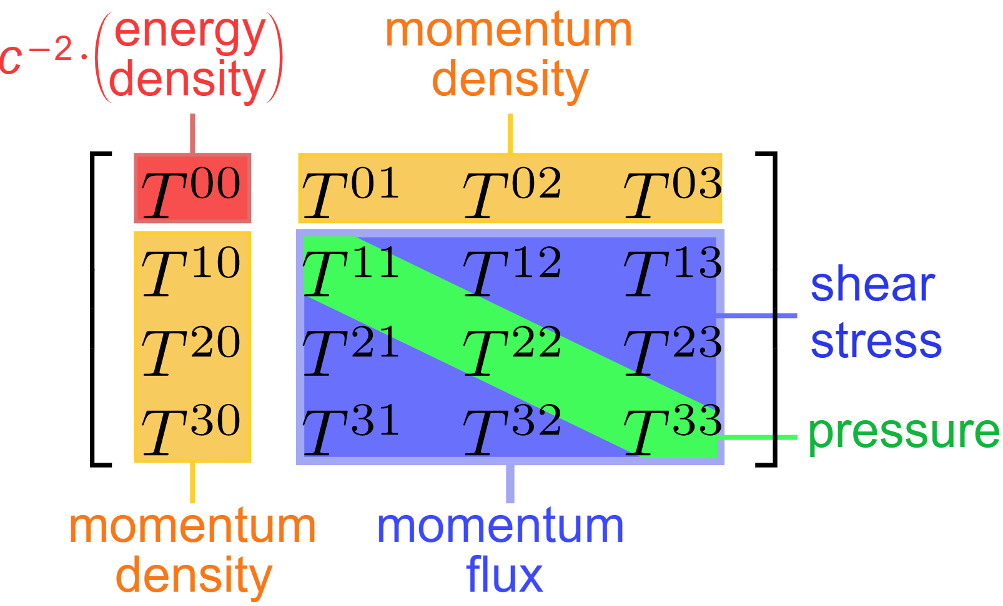
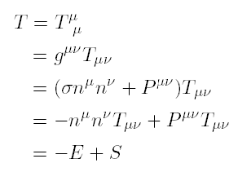
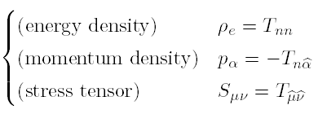
3+1 decomposition (Energy-momentum tensor)
Eulerian observer (observer moving along a normal vector)
V
$$n$$
1

Slide 32
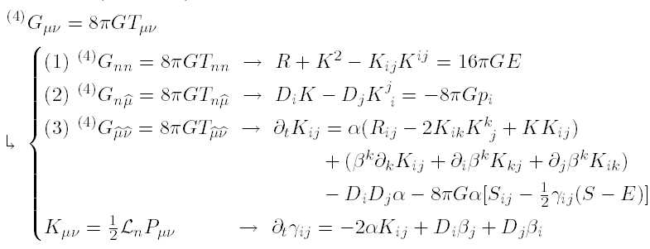
Now, we need to decompose Ricci tensor.
Hamilton/Momentum constraint eq.
Evolution eq.

Slide 33
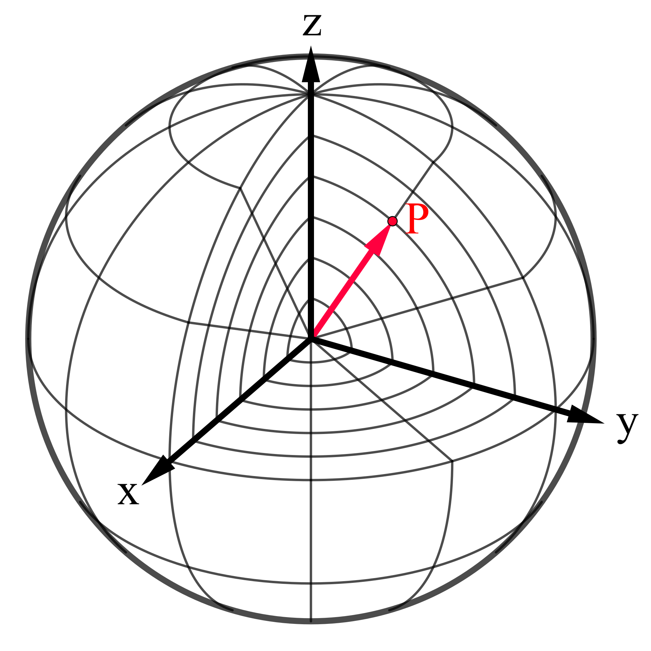
3+1 Decomposition to hypersurface quantities
We need to understand
the quantities of the hypersurface.

Slide 34
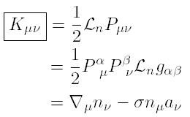
Fundamental form of hypersurface
1st fundamental form of the hypersurface: Projection tensor > project all tensors on to the hyper surface
2nd fundamental form of the hypersurface: Change of projection tensor along the normal direction > bended hypersurface >> Extrinsic curvature

Slide 35
Derivatives in definition of Kμν
Vector derivatives describe how a vector has changed relative to a reference vector.
Covariant derivative ∇μ: Vector change relative to a parallelly transported vector
Lie derivative LV : Vector change along the flow of another vector field
X
φ
V
V
Y

Slide 36
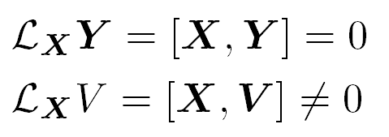
Derivatives in definition of Kμν
Vector derivatives describe how a vector has changed relative to a reference vector.
Covariant derivative ∇μ: Vector change relative to a parallelly transported vector
Lie derivative LV : Vector change along the flow of another vector field
X
φ
V
V
Y

Slide 37
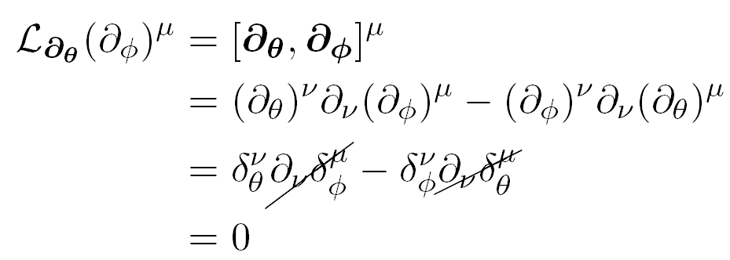
Derivatives in definition of Kμν
φ
X
V
V
Y

Slide 38
Definitions of Kμν

Slide 39
Example of Kμν .

Slide 40
Intrinsic properties of Pμν, Kμν

Slide 41
Intrinsic curvature
φ
V
[Gourgoulhon, 2021]

Slide 42
Intrinsic curvature (2. Gauss eq. (1))

Slide 43
Intrinsic curvature (3. Gauss eq. (2))

Slide 44
Intrinsic curvature (4. Gauss eq. (3))

Slide 45
Intrinsic curvature (4. Gauss eq. (4))

Slide 46
Intrinsic curvature (5. Codazzi eq.)

Slide 47
Summarry

Slide 48
Example of intrinsic curvature
Dimensional analysis of K and R

Slide 49
3+1 Decomposition (Einstein eq. (1-1))
[Gourgoulhon, 2021]

Slide 50
3+1 Decomposition (Einstein eq. (1-2))
[Gourgoulhon, 2021]

Slide 51
3+1 Decomposition (Einstein eq. (2-1))
[Gourgoulhon, 2021]

Slide 52
3+1 Decomposition (Einstein eq. (2-2))
[Gourgoulhon, 2021]

Slide 53
3+1 Decomposition (Einstein eq. (3-1))
[Gourgoulhon, 2021]

Slide 54
3+1 Decomposition (Einstein eq. (3-2))
[Gourgoulhon, 2021]

Slide 55
3+1 Decomposition (Einstein eq. (3-3))
[Gourgoulhon, 2021]

Slide 56
3+1 Decomposition (Einstein eq. (3-4))

Slide 57
3+1 Decomposition (Einstein eq. (3-5))

Slide 58
3+1 Decomposition (Einstein eq. (3-6))
[Gourgoulhon, 2021]

Slide 59
3+1 Decomposition (Einstein eq. (4-1))
[Gourgoulhon, 2021]

Slide 60
3+1 Decomposition (Einstein eq. (4-2))
$$\left|m\right|… lapse$$
2
1
0 1 2
$$n m$$

Slide 61
3+1 Decomposition (Einstein eq. (4-3))
>>> Intrinsic eq. with coordinates on the hypersurface

Slide 62
3+1 Decomposition (Einstein eq. (4-4))
>>> Intrinsic eq. with coordinates on the hypersurface

Slide 63
3+1 Decomposition (Einstein eq.)

Slide 64
To apply 3+1 eq’s in NR
Hamilton/Momentum constraint eq.
Evolution eq.

Slide 65
Initial data construction (Conformal transverse traceless decomposition)

Slide 66
Initial data construction
(Thin-sandwich formalism)

Slide 67
Evolution: BSSN formalism
The modes that violates the momentum constraint propagate with speed zero in the ADM equations.
These modes lead to instabilities when non-linear source terms are included.
In the BSSN system, the momentum violating modes propagate with non-zero speed and propagate off the numerical grid, presumably stabilizing the simulation.

Slide 68
More about NR applications

Slide 69
NR works: Simulation of BBH merger

Slide 70
NR works: Simulation of BBH merger

Slide 71
NR works: Simulation of BBH merger

Slide 72
NR works: Simulation of BBH encounters

Slide 73
NR works: Simulation of BBH encounters

Slide 74
NR works: Simulation of BBH encounters

Slide 75
ADM formalism
Richard Arnowitt(-14,86), Stanley Deser(-23,92) and Charles Misner(-23,91)
at the ADM-50: A Celebration of Current GR Innovation conference
held in November 2009 to honor the 50th anniversary of their paper.

Slide 76
With ADM formalism

Slide 77
ADM formalism to ADM mass

Slide 78
ADM formalism (Hilbert action decomposition)

Slide 79
ADM formalism (canonical variable)

Slide 80
ADM formalism (conjugate momentum)

Slide 81
ADM formalism (ADM Hamiltonian)

Slide 82
ADM formalism (boundary term)

Slide 83
ADM formalism (Gibbons-Hawking term)

Slide 84
ADM formalism (gravitational Hamiltonian including GH term)

Slide 85
ADM formalism (canonical variable)

Slide 86
ADM formalism (ADM mass)

Slide 87
ADM formalism to ADM mass
M

Slide 88
What have we learned?
Now, we understand…
Einstein equation
Foliation of the spacetime
Intrinsic quantities of hypersurfaces
3+1 decomposition of the Einstein eq.
NR application
ADM formalism and ADM quantities

Slide 89
Enjoy spacetime travel!

